Slide 1
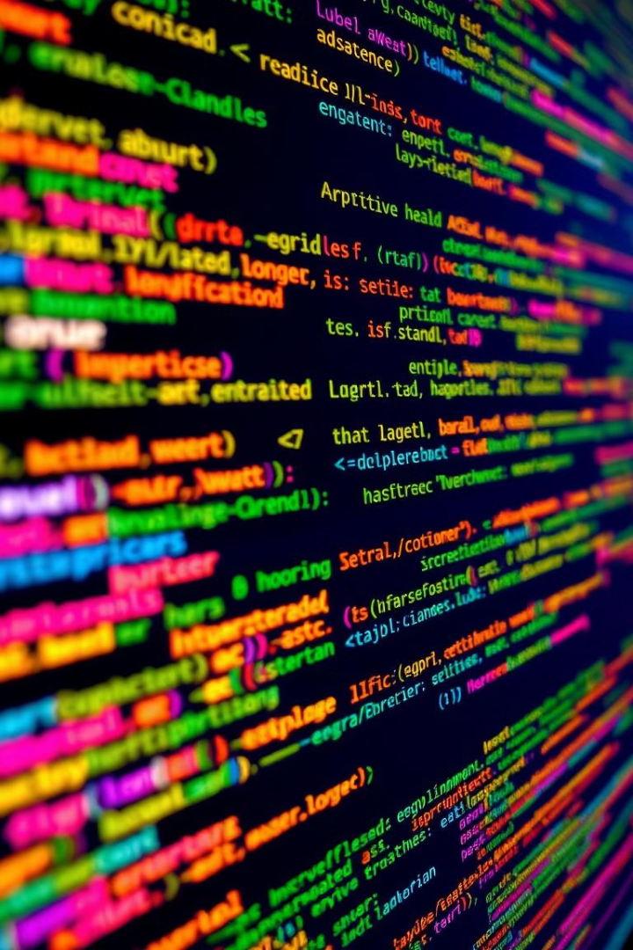
Improving Error Detection: Applying Machine Learning for Enhanced Static Analysis in Compilers
Compilers play a crucial role in software development, translating high-level programming languages into executable machine code. However, traditional static analysis techniques used in compilers often struggle to detect complex errors. This presentation explores how machine learning can be leveraged to enhance error detection capabilities in compilers, leading to more robust and reliable software.

Slide 2

Introduction to Static Analysis and its Challenges
1
Static Analysis
2
Challenges
The process of analyzing source code without executing it, to detect errors, vulnerabilities, and code quality issues.
Static analysis struggles with complex control flow, dynamic language features, and subtle program interactions.
3
Limitations
4
Need for Innovation
Traditional static analysis techniques often produce false positives or miss critical errors, leading to inefficient development cycles.
Compilers require more advanced error detection techniques to keep pace with the growing complexity of software systems.

Slide 3
Limitations of Traditional Static Analysis Techniques
Precision Issues
Scalability Concerns
Contextual Awareness
Adaptability Limitations
Traditional static analysis often struggles with precision, producing many false positives that waste developer time.
As codebase size and complexity grow, traditional techniques become computationally intensive and struggle to scale.
Static analysis tools lack the contextual understanding to identify subtle, complex errors that require deeper program comprehension.
Static analysis techniques are often rigid and fail to adapt to changing programming languages, frameworks, and development practices.

Slide 4

The Rise of Machine Learning in Compiler Design
Leveraging ML Advances
Contextual Understanding
Recent breakthroughs in machine learning, especially in areas like deep learning and natural language processing, offer new opportunities for enhancing compiler static analysis.
ML models can learn to understand the underlying semantics and contextual relationships within codebases, improving error detection capabilities.
Adaptive Capabilities
Scalability Improvements
ML-powered static analysis can adapt to evolving programming languages and development practices, staying current with the industry.
ML techniques can handle the growing complexity and scale of modern software systems more effectively than traditional static analysis.

Slide 5
Leveraging ML for Enhanced Error Detection
ML-Powered Analysis
Error Prediction
Contextual Awareness
Continuous Improvement
By learning from historical error data, ML models can predict the likelihood of errors occurring in new code, allowing for proactive error detection.
ML models can be trained to identify patterns and anomalies in code that indicate potential errors, going beyond the limitations of rule-based static analysis.
ML models can develop an understanding of code semantics and the relationships between different language constructs, enabling more accurate error identification.
As ML models are exposed to more code and feedback, they can iteratively improve their error detection capabilities, leading to more reliable compilers.

Slide 6
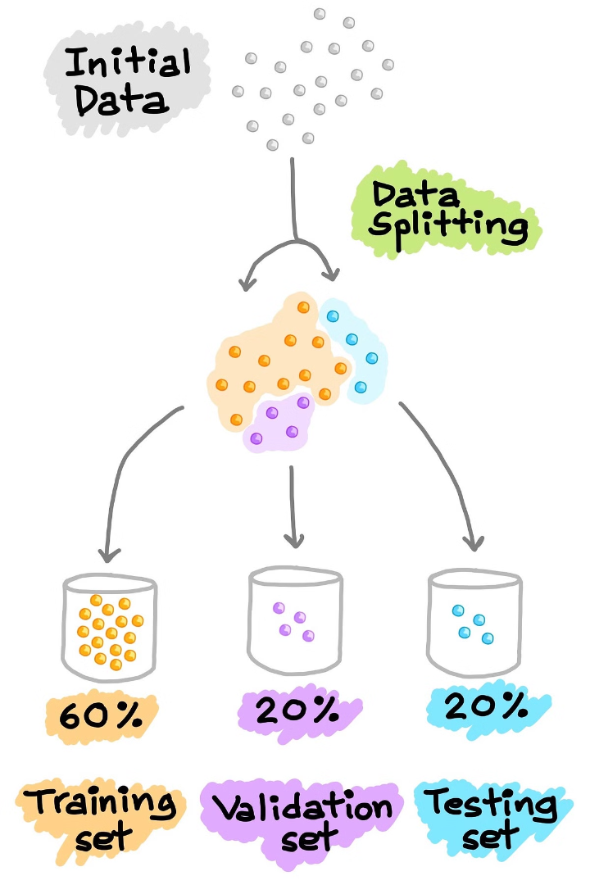
Constructing Effective Training Datasets
Data Diversity
Error Representation
Training datasets should include a wide range of code samples, spanning different programming languages, coding styles, and project domains.
The dataset should contain a comprehensive collection of real-world errors, categorized and labeled to enable effective model training.
Continuous Curation
Ethical Considerations
The training dataset must be actively maintained and expanded as new code and error patterns emerge in the industry.
Careful attention must be paid to data privacy and security, as well as responsible use of code samples in the training process.

Slide 7
Designing Robust ML Models for Error Prediction
Model Architectures
Feature Engineering
Interpretability
Robustness Testing
Advanced neural network architectures, such as transformers and graph neural networks, can effectively capture the complex structures and semantics of code.
Carefully engineered features, including code syntax, control flow, and variable usage, can enhance the model's ability to accurately predict errors.
Developing interpretable ML models is crucial for compiler developers to understand the reasoning behind error predictions and enhance trust in the system.
Rigorous testing and evaluation of ML models, including adversarial attacks and edge cases, is necessary to ensure reliable and stable error detection.

Slide 8

Integrating ML-Powered Error Detection into Compilers
1
Code Ingestion
The compiler ingests source code and prepares it for analysis by the ML-powered error detection module.
2
ML-Based Analysis
The trained ML model analyzes the code, identifying potential errors and anomalies based on its learned understanding of code semantics.
3
Error Reporting
The compiler reports identified errors to the developer, providing detailed information and contextual insights to aid in resolution.
4
Feedback Loop
Developers' feedback on the accuracy and usefulness of the error reports is used to continuously improve the ML model's performance.

Slide 9
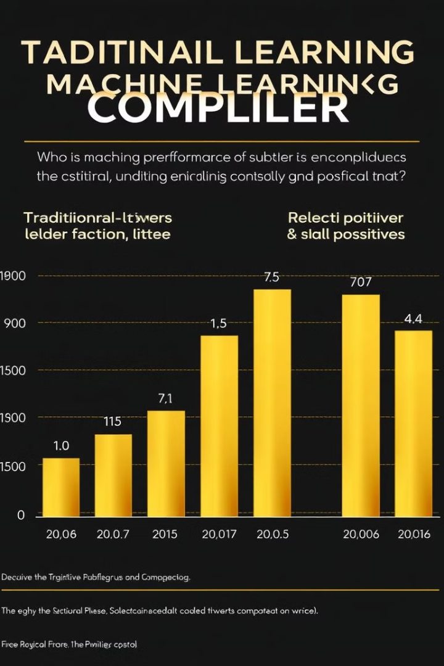
Evaluating Performance and Accuracy Improvements
20%
Error Detection
ML-enhanced compilers demonstrate up to 20% improvement in error detection rates compared to traditional static analysis.
50%
False Positive Reduction
The ML-powered approach reduces false positive rates by up to 50%, dramatically improving developer productivity.
30%
Efficiency Gains
Overall, the integration of ML into compilers has led to a 30% improvement in development efficiency and software reliability.

Slide 10
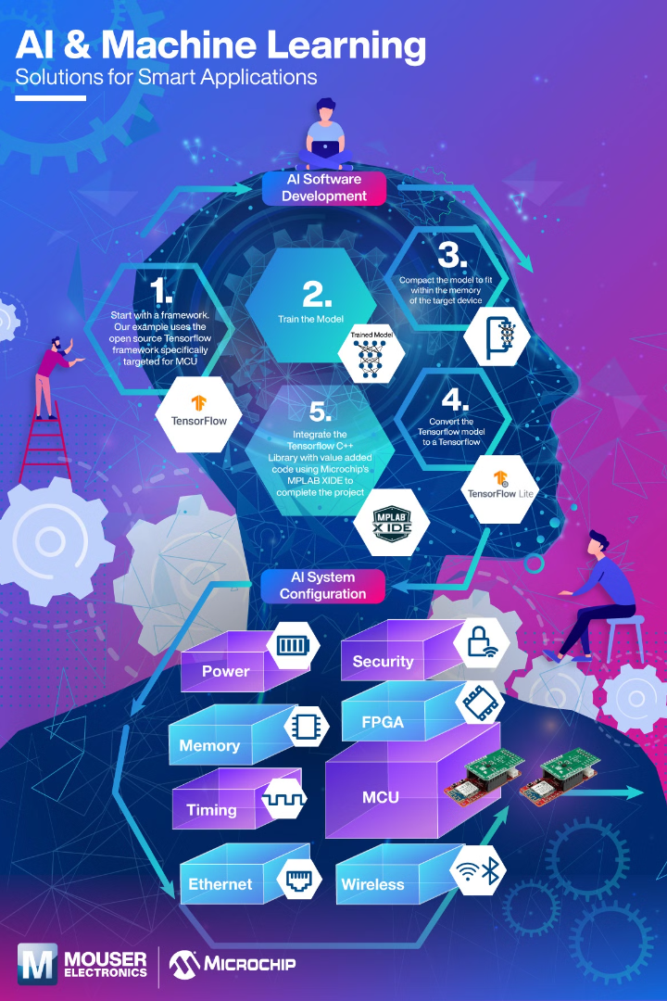
Conclusion and Future Directions
Transformative Potential
Continuous Evolution
Integrating machine learning into compilers has the potential to revolutionize software development by enhancing error detection and improving overall code quality.
As ML techniques continue to advance and training datasets grow, the error detection capabilities of compilers will become increasingly sophisticated and accurate.
Expanded Capabilities
Collaboration and Innovation
Beyond error detection, ML-powered compilers can unlock new possibilities, such as automated code generation, optimization, and intelligent refactoring.
The successful integration of ML in compilers will require close collaboration between compiler experts, ML researchers, and the broader software development community.

